Slide 1

  Retail Grocery Management System

Slide 2
About Team Members :
Santhoshkumar (B.Tech_Mech)
3.5 years having experience in mechanical domain.
LinkedIn - Link GitHub – Link
-----------------------------------------------------------------
Mukthi Manohar (Degree)
Linkedln - Mukthi Manohar | LinkedIn
-----------------------------------------------------------------
Kakarla Jagadeshwar (B.Tech_CSE)
LinkedIn - Link GitHub - Link

Slide 3
Agenda (This should be the PPT flow)
Objective of the Project
ER Diagram and schema explanation
Key analysis questions (use cases)
SQL query results with screenshots or summaries
Final business insights and recommendations
Conclusion (Key finding overall)
Q&A Slide

Slide 4
Objective of the Project :
To design and implement a relational database for a grocery store.
To retrieve and manipulate data using SQL queries.
To perform data analysis for business insights such as top customers,
best-selling products, and revenue trends.
To practice using joins, aggregations, subqueries, and filtering techniques.

Slide 5
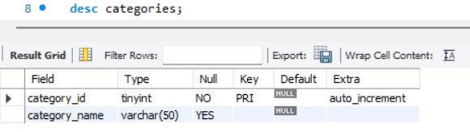
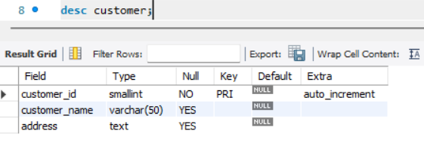
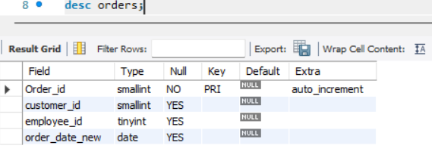
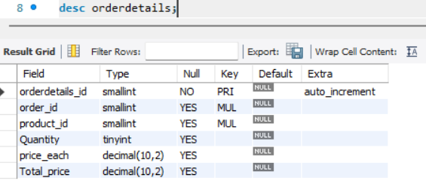
Tables Structure :

Slide 6
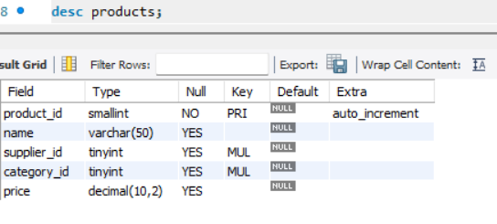
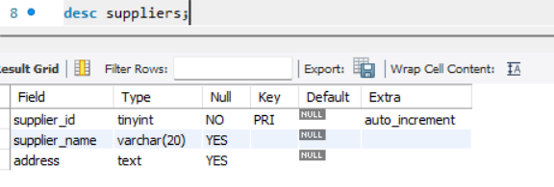
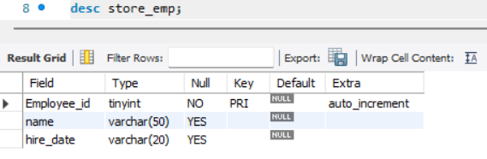

Slide 7
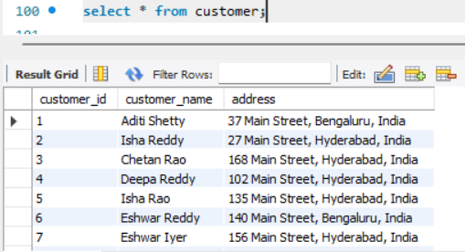
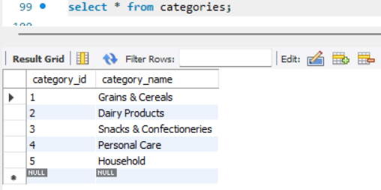
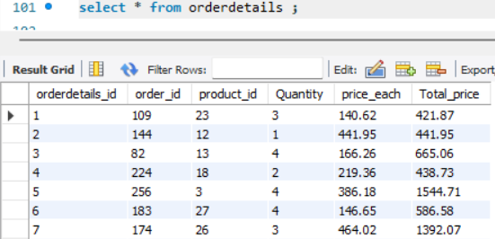
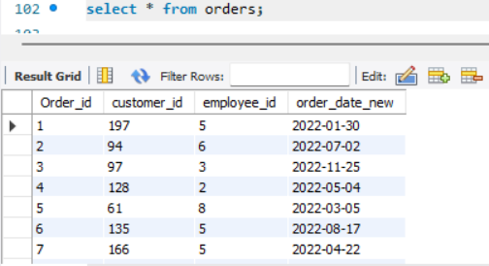
Data Insertion :

Slide 8
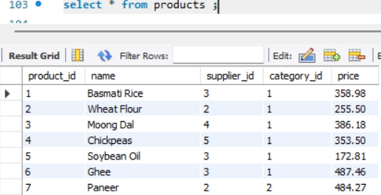
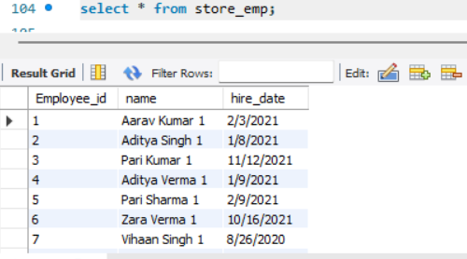
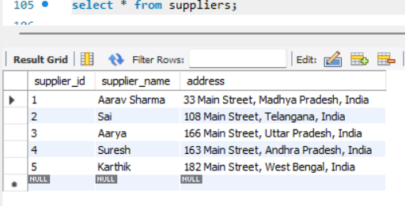

Slide 9
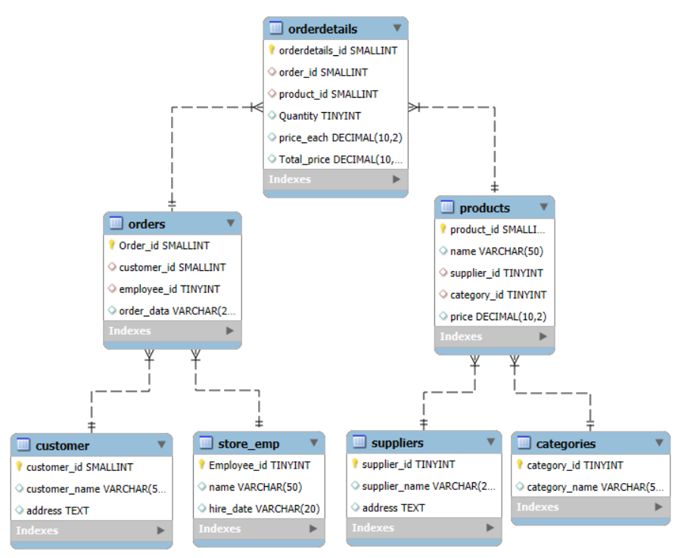
ER Diagram and schema explanation :

Slide 10
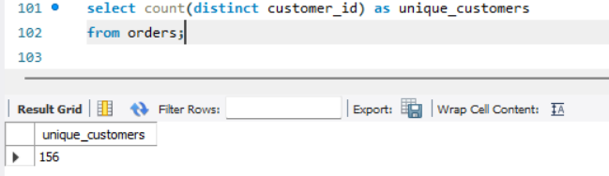
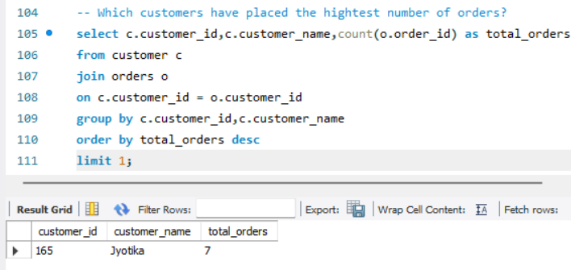
Customer Insights :
1.How many unique customers have place orders?
The result shows 156 unique customers in the orders table.
2.Which customers have placed the highest number of orders?
The result shows Jyotika placed the most orders, with a total of 7 orders.

Slide 11
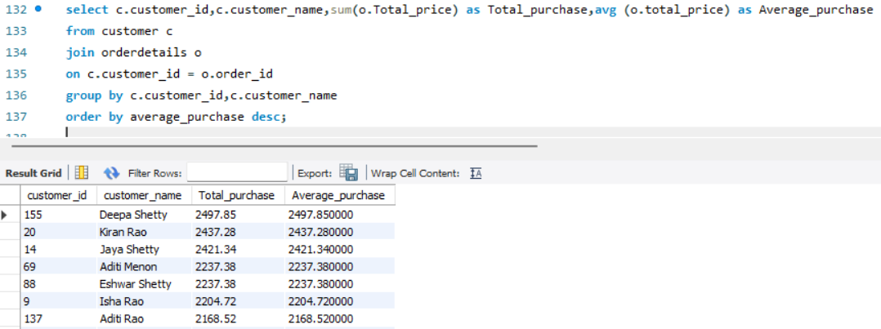
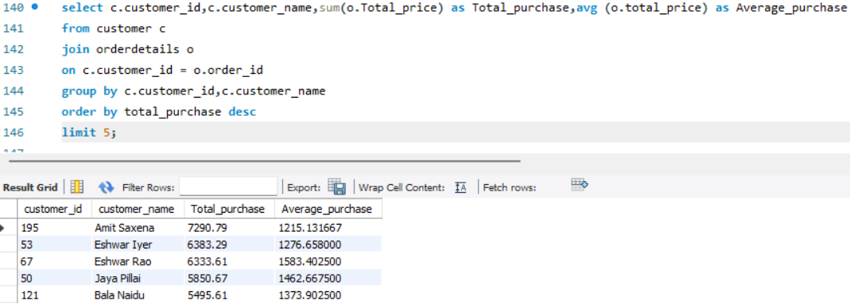
3.What is the total and average purchase value per customer?
Deepa Shetty has the highest average purchase (2497.85).
4.Who are the top 5 customers by total purchase amount?
Amit Saxena is the highest spending customer with a total purchase of (7290.79).

Slide 12
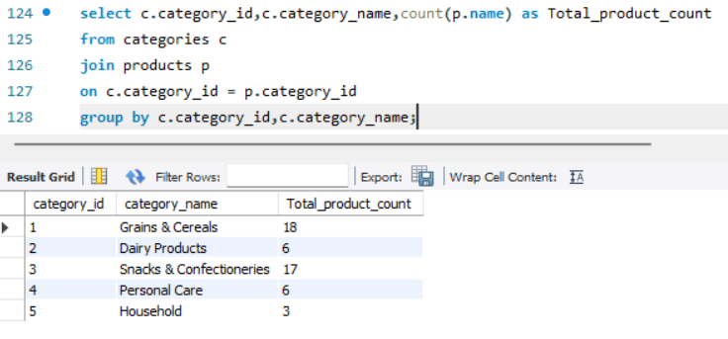
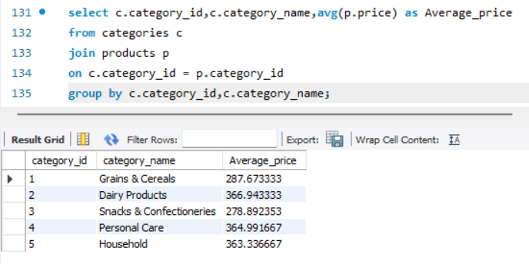
Product Performance :
1.How many products exist in each category?
Grains & Cereals and Snacks & Confectioneries have the highest number of products.
2.What is the average price of products by category?
Dairy Products, Personal Care, and Household categories have the highest average prices.

Slide 13
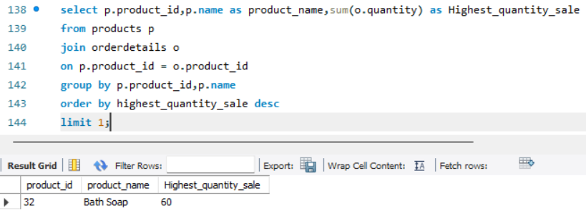
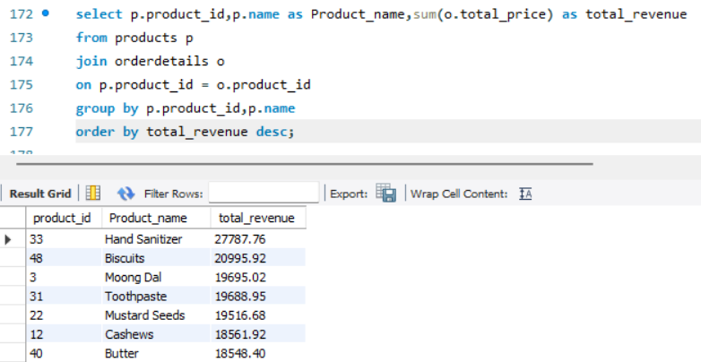
3.Which products have the highest total sales volume (by quantity)?
Bath Soap is the highest-selling product by quantity, with a total sale of 60 units.
4.What is the total revenue generated by each product?
Hand Sanitizer is the top-performing product in terms of revenue, while Butter generates the least revenue among the listed products.

Slide 14
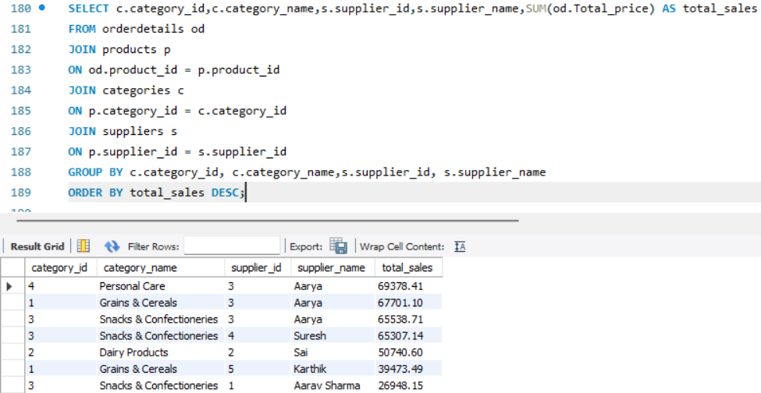
5.How do product sales vary by category and supplier?
Aarya is the dominant supplier across most high-revenue categories.
Snacks & Confectioneries is a high-demand category with multiple strong suppliers.
Some suppliers (Karthik) may need sales improvement strategies or better product placement.

Slide 15
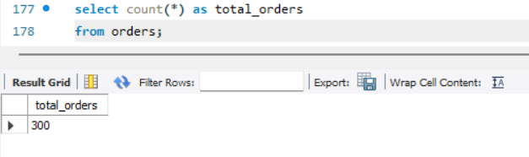
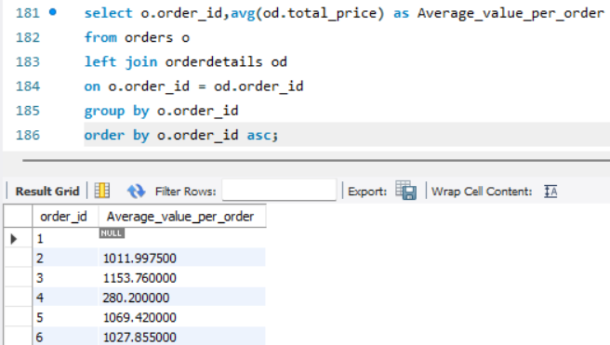
Sales and Order Trends :
1.How many orders have been placed in total?
With 300 orders, the business has a good volume of data to identify top-selling products and optimize inventory and supply.
2.What is the average value per order?
Most orders have an average value between 133 and 2497.
Presence of NULL values indicates incomplete or empty orders that may need data validation.

Slide 16
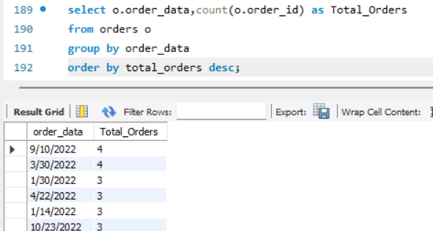
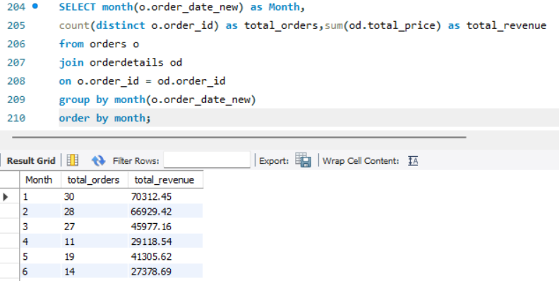
3.On which dates were the most orders placed?
The highest number of orders in a single day is 4 orders.
Example dates: 9/10/2022 and 3/30/2022
4.What are the monthly trends in order volume and revenue?
The business performed strongly in the first two months, with January generating the highest revenue. However, order volume and revenue declined in later months, showing an inconsistent monthly trend.

Slide 17
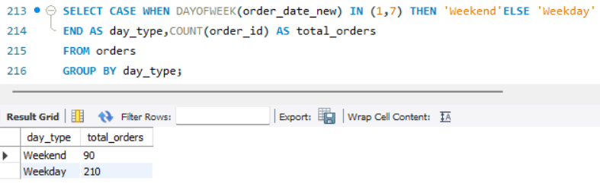
5.How do order patterns vary across weekdays and weekends?
Weekdays recorded 210 orders, which is more than double the weekend orders.
The business is weekday-driven, so stock and staffing should be higher on weekdays.

Slide 18
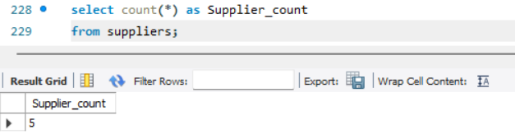
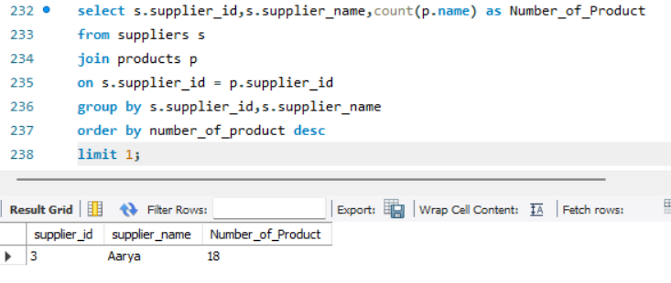
Supplier Contribution :
1.How many suppliers are there in the database?
The system has 5 suppliers in total.
2.Which supplier provides the most products?
Aarya plays a key role in product availability and variety.
This makes Aarya the primary and most diversified supplier in the system.

Slide 19
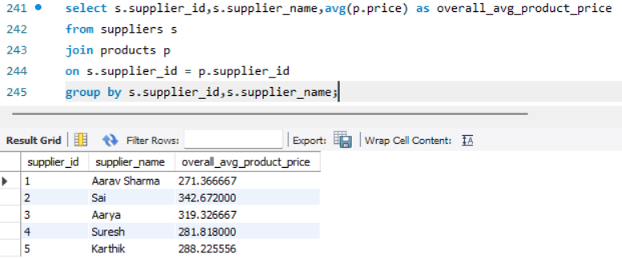
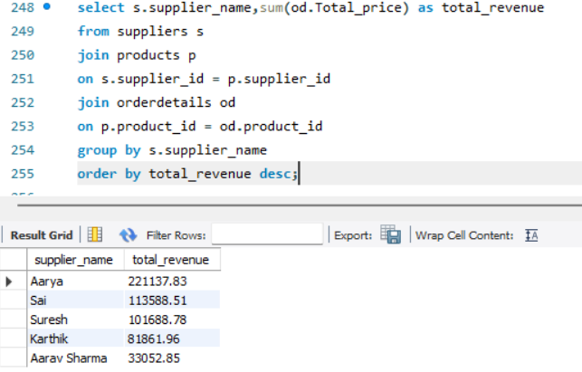
3.What is the average price of products from each supplier?
Sai has the highest overall average product price, indicating higher-priced products compared to other suppliers.
4.Which suppliers contribute the most to total product sales (by revenue)?
Suppliers with a broader product range and higher sales volume (Aarya) drive maximum revenue, highlighting the importance of strong supplier partnerships for business growth.

Slide 20
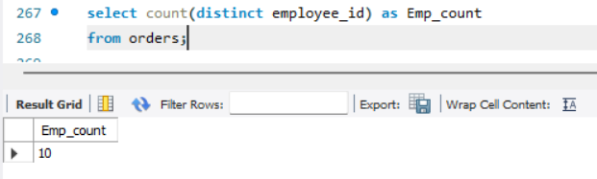
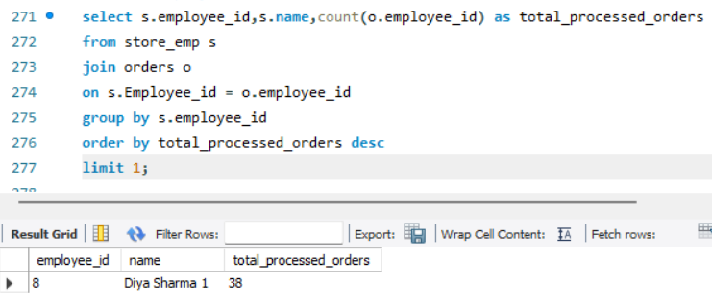
Employee Performance :
1.How many employees have processed orders?
A total of 10 employees have processed customer orders.
2.Which employees have handled the most orders?
Diya Sharma is a top-performing employee, indicating high efficiency and a significant contribution to order processing operations.

Slide 21
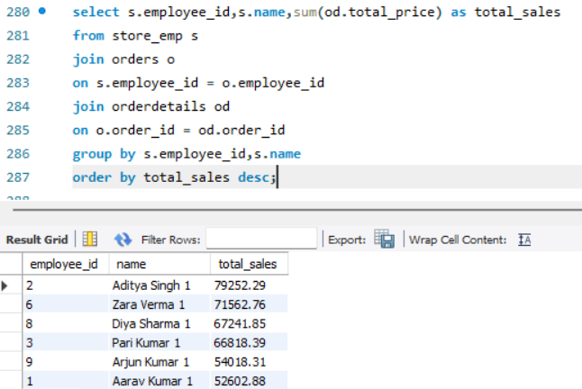
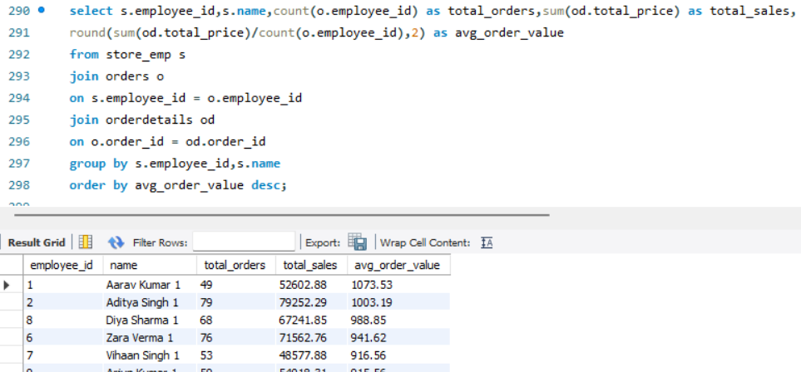
3.What is the total sales value processed by each employee?
Aditya Singh generated the highest total sales, amounting to ₹79,252.29, among all employees.
4.What is the average order value handled per employee?
Aarav Kumar has the highest average order value (₹1,073.53), despite having fewer total orders compared to others.

Slide 22
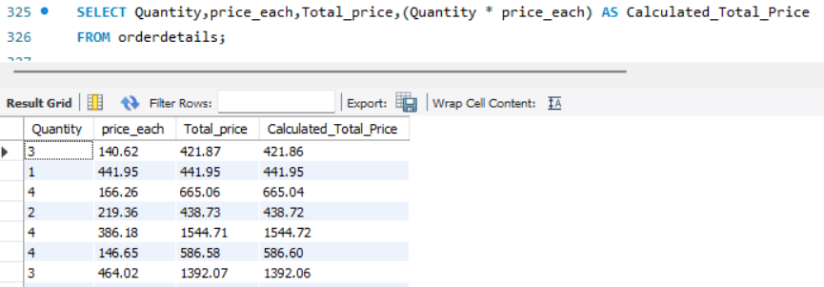
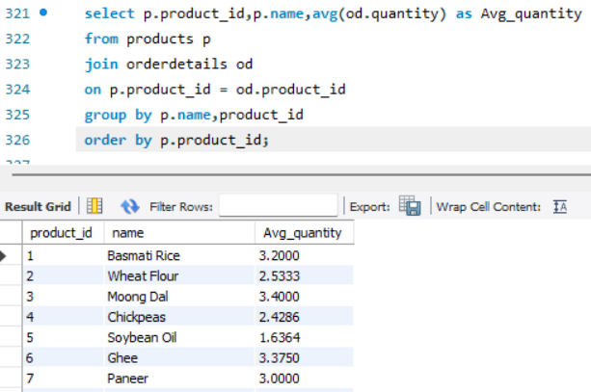
Order Details Deep Dive :
1.What is the relationship between quantity ordered and total price?
There is a direct (positive) relationship between quantity and total price. As quantity increases, total price increases proportionally.
2.What is the average quantity ordered per product?
Products like Ghee, Moong Dal, Basmati Rice, and Paneer have a higher average quantity per order, indicating bulk purchases.

Slide 23
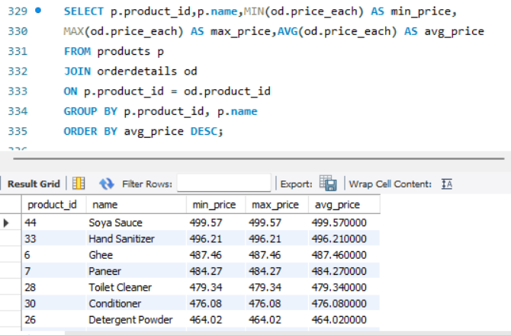
3.How does the unit price vary across products and orders?
Products such as Soya Sauce, Hand Sanitizer, Ghee, and Paneer have the highest average prices among all products.
These products are positioned as premium or fixed-price items, suggesting limited discounting and strong price control, which can help maintain profit margins.

Slide 24
Conclusion:
The store has 300 total orders, showing consistent customer activity.
Weekdays generate the majority of sales (210 orders), so they are the peak business days.
Top-selling products are essential daily items like Eggs, Instant Noodles and Soybean Oil which drive most of the revenue.
Aarya is the leading supplier, providing the highest number of products and contributing to top category sales.
Personal Care, Grains & Cereals and Snacks are the highest revenue-generating categories.
Most customers have an average order value around 133–2497, indicating steady spending behavior.

Slide 25

THANK YOU

